Slide 1
The Hidden World of Residual Stresses
Ayush Shenoy
Sathaye College
National Science Day 2024

Slide 2
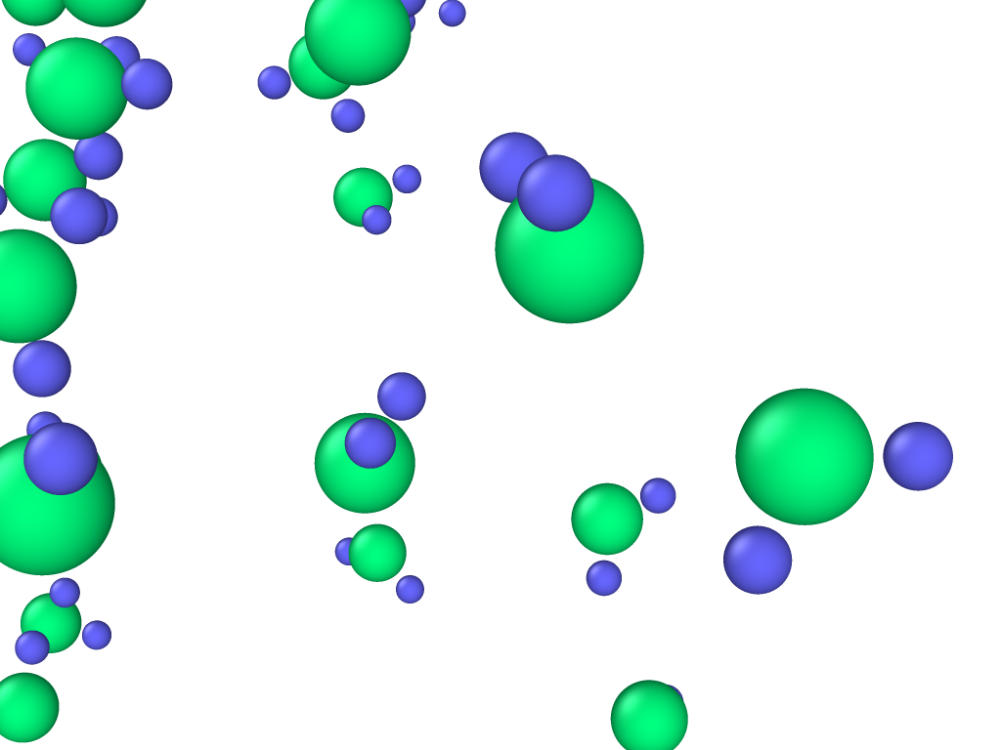
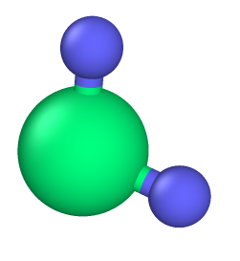
1
Oxygen
2
Hydrogen
Water

Slide 3


Slide 4
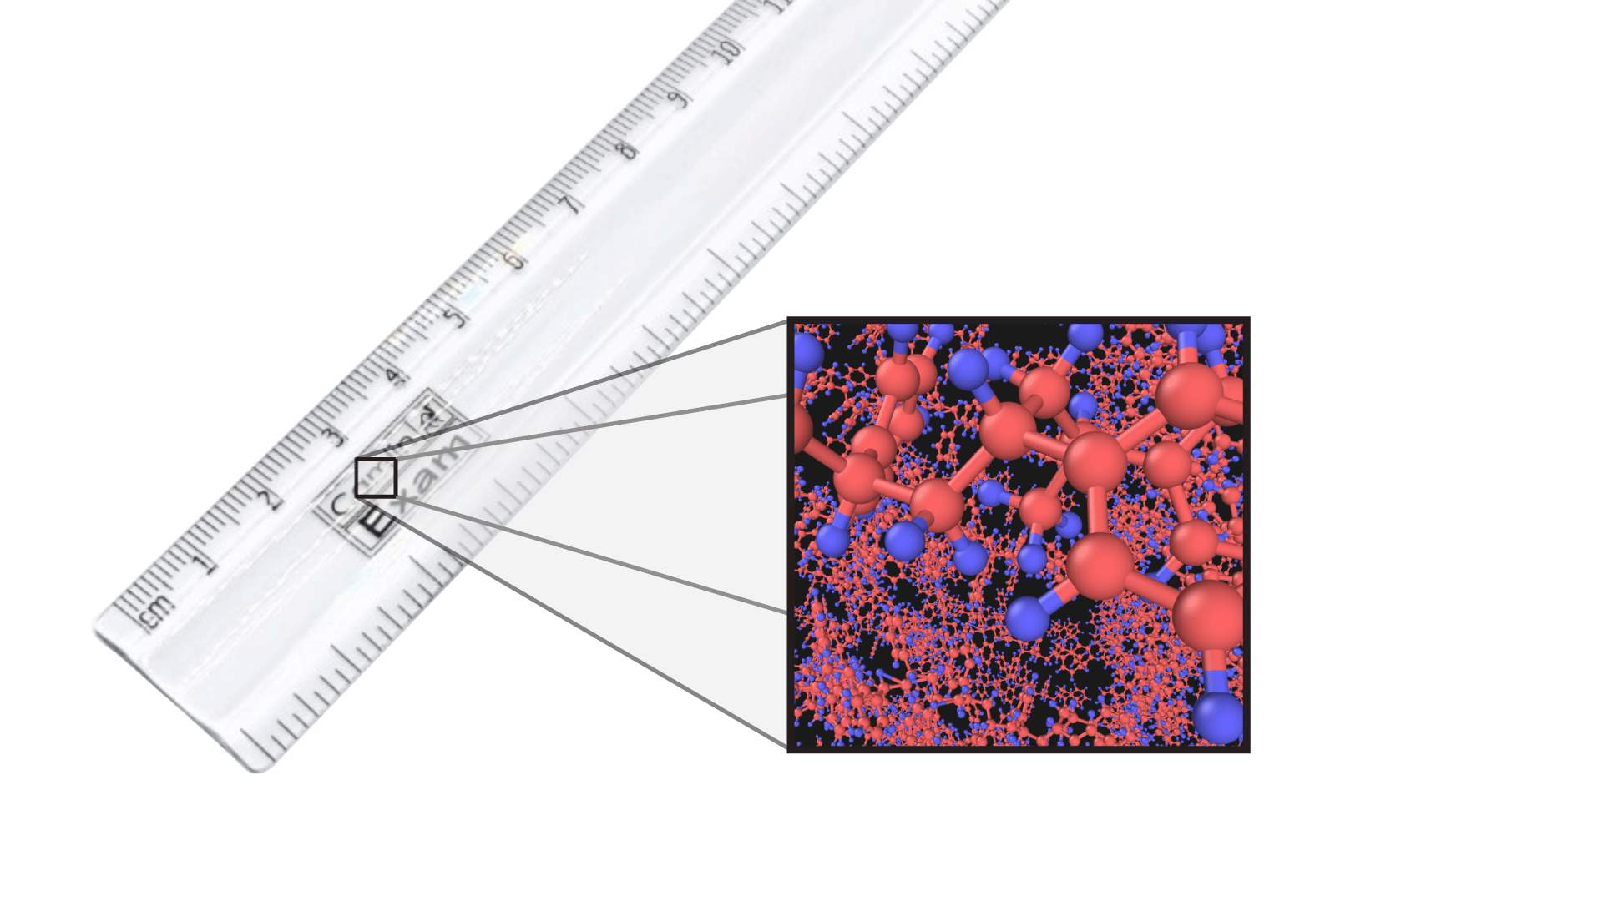
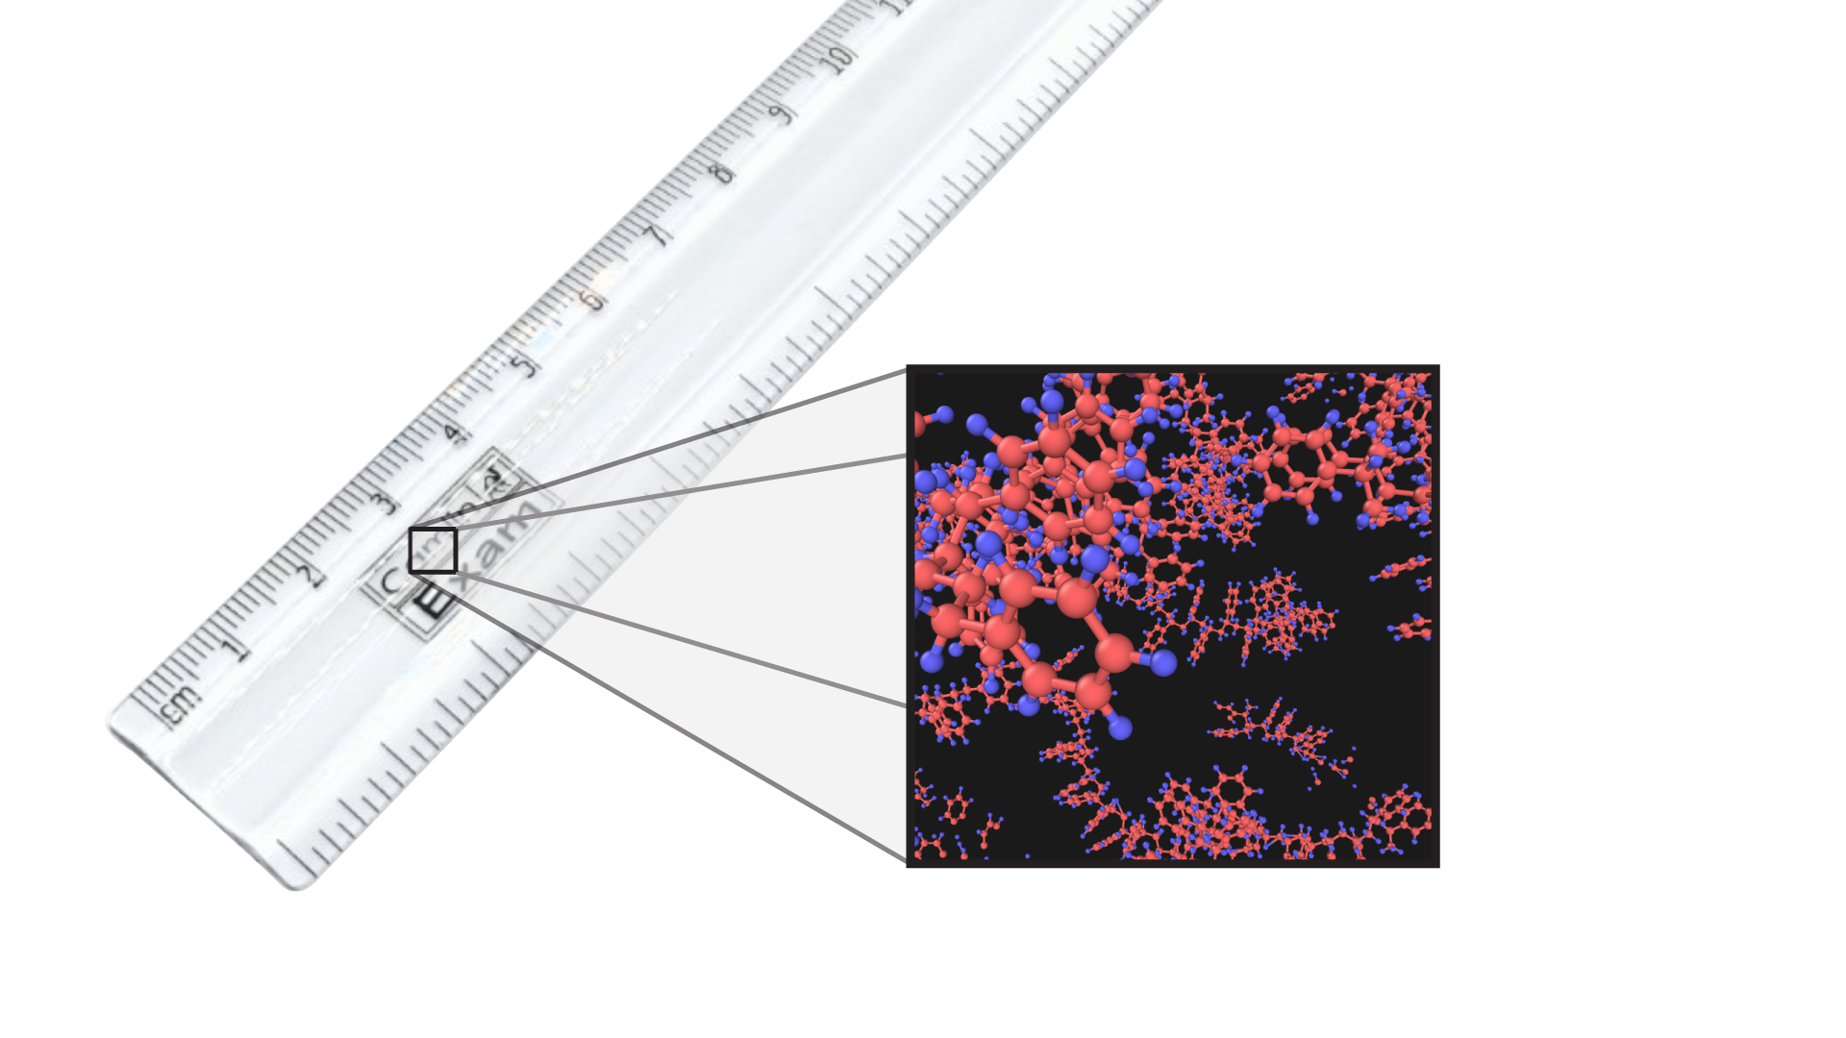

Slide 5
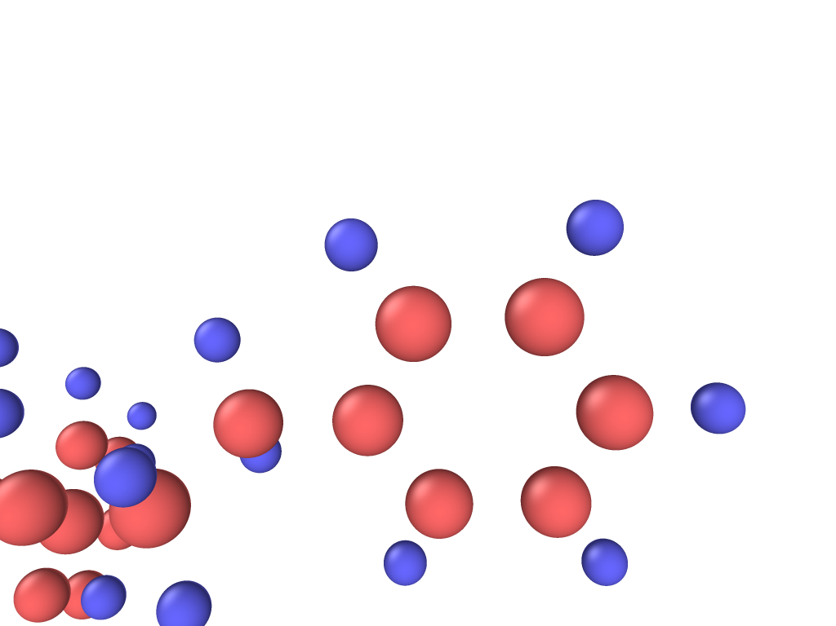
Carbon
Hydrogen

Slide 6
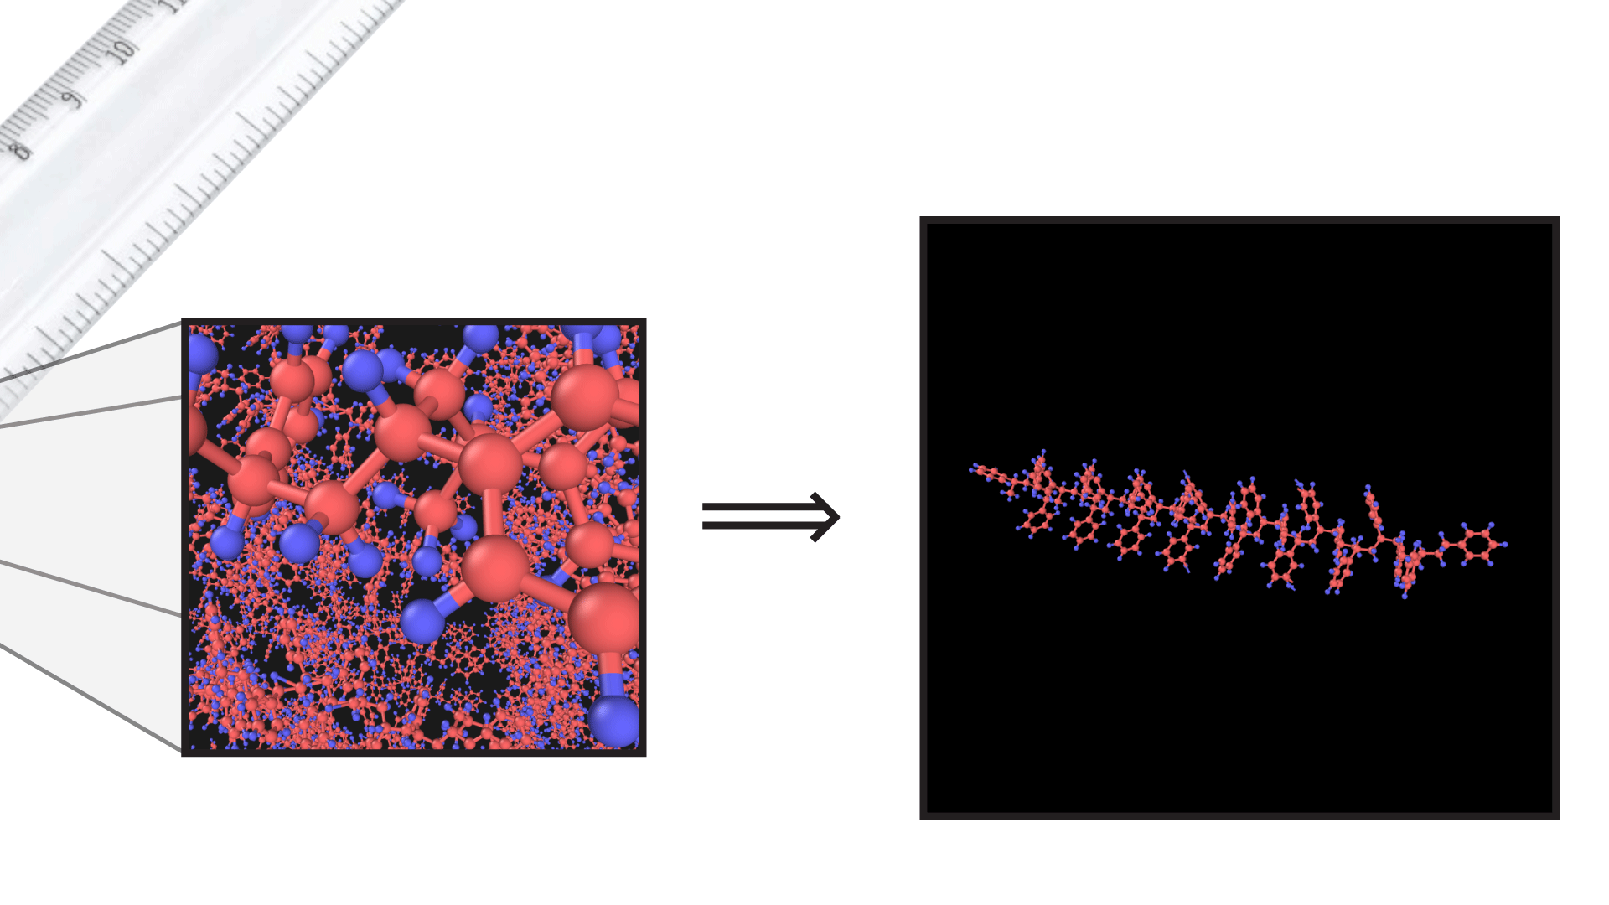
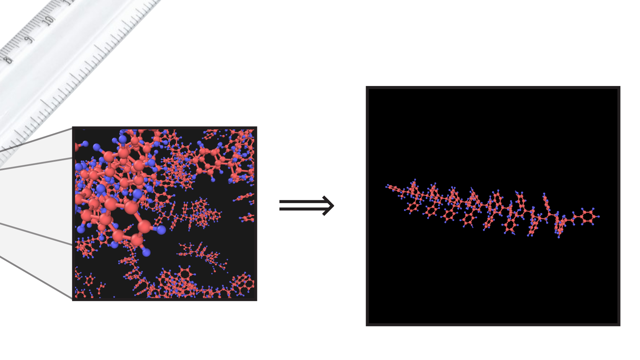
Carbon
Hydrogen

Slide 7
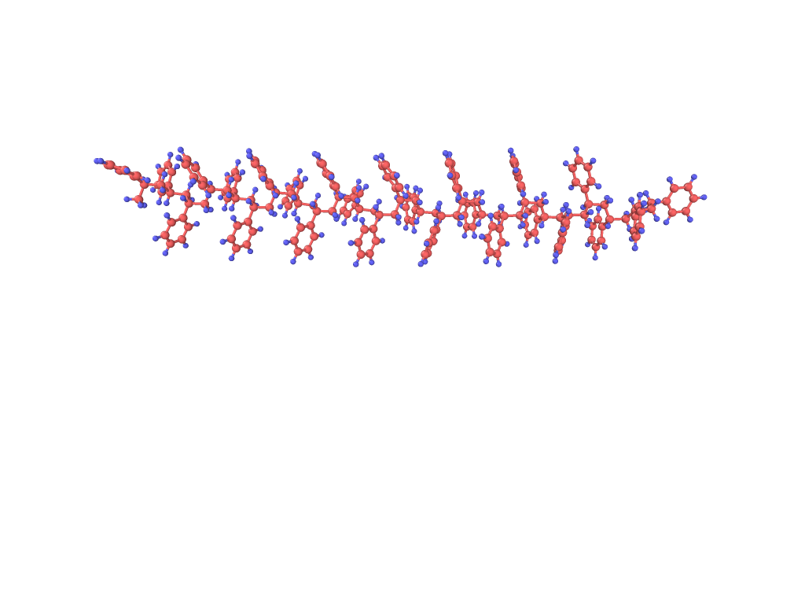
Fixed
PULL

Slide 8
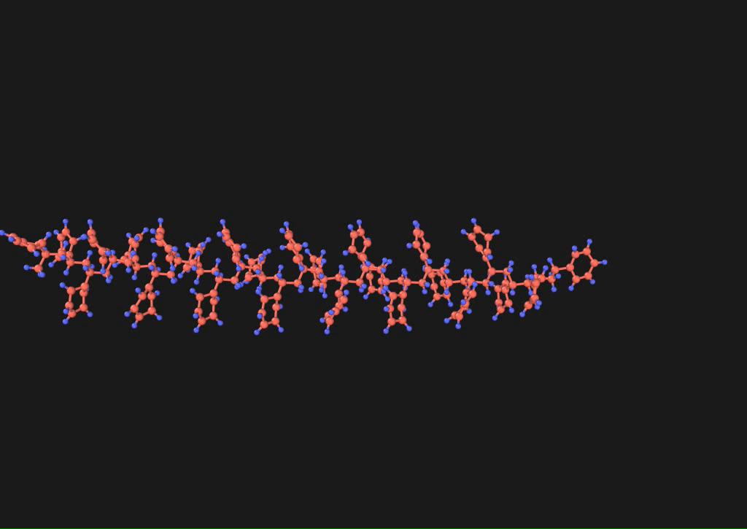

Slide 9
Stresses without external force?

Slide 10
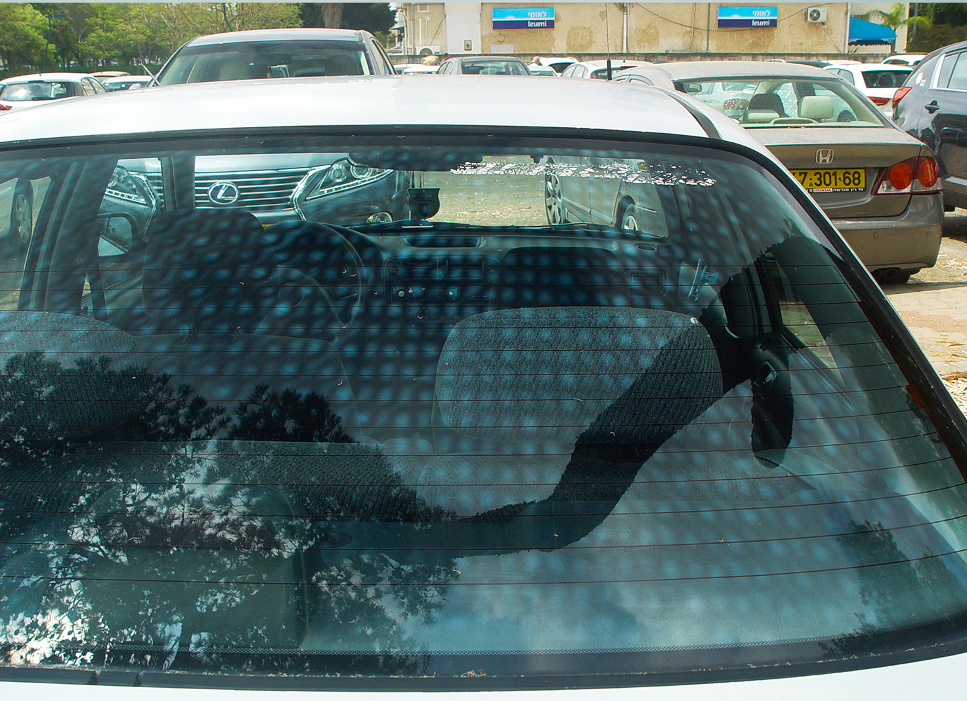

Slide 11
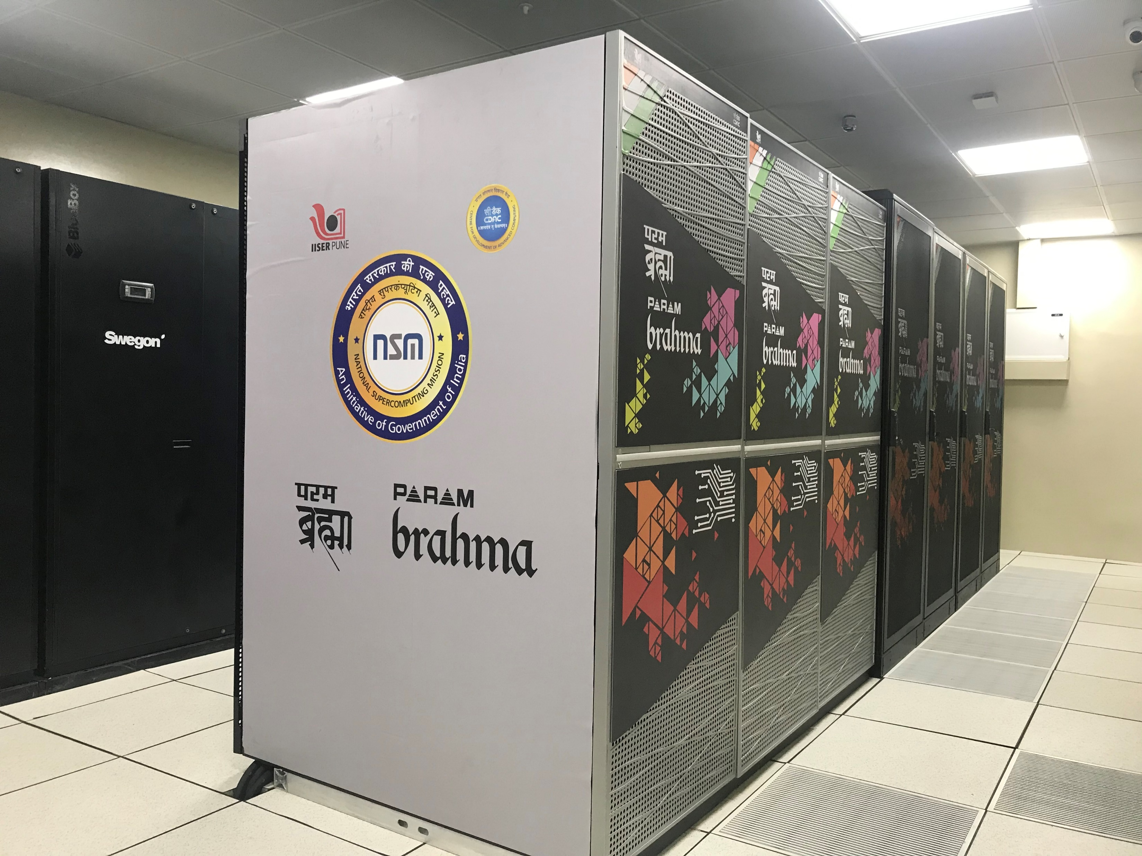
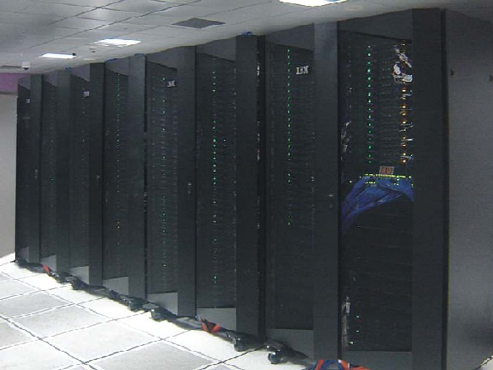
Some magic cameras:
Parambrahma @ IISER Pune
Virgo @ IIT Madras

Slide 12


Slide 13
Thank You
☺

